Slide 1
PROBLEM STATEMENT
Read a picture pixel by pixel.
Extract the corresponding RGB intensity values.
Convert them into corresponding Y , R-Y , B-Y values , their respective frequencies and store in a text file.
Initiate USART in ATmega128A.
To give input and observe output using Pyserial.
To write the values in EEPROM.

Slide 2
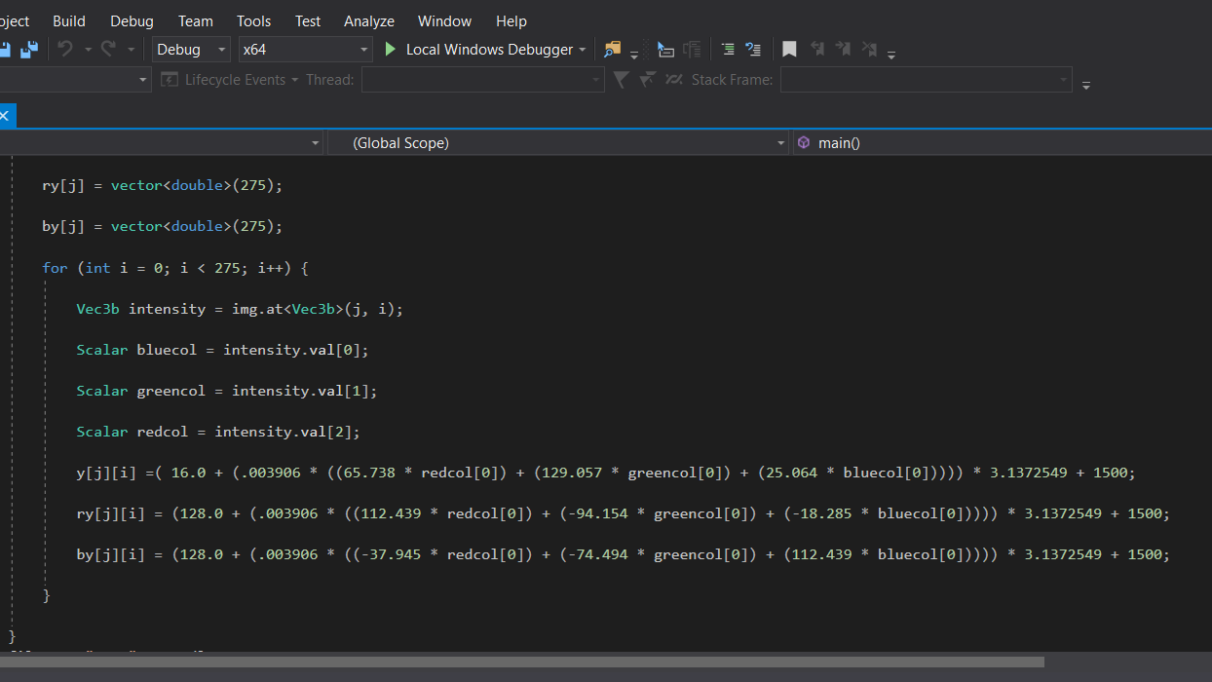
EXTRACTION OF RGB VALUES AND CONVERSION

Slide 3
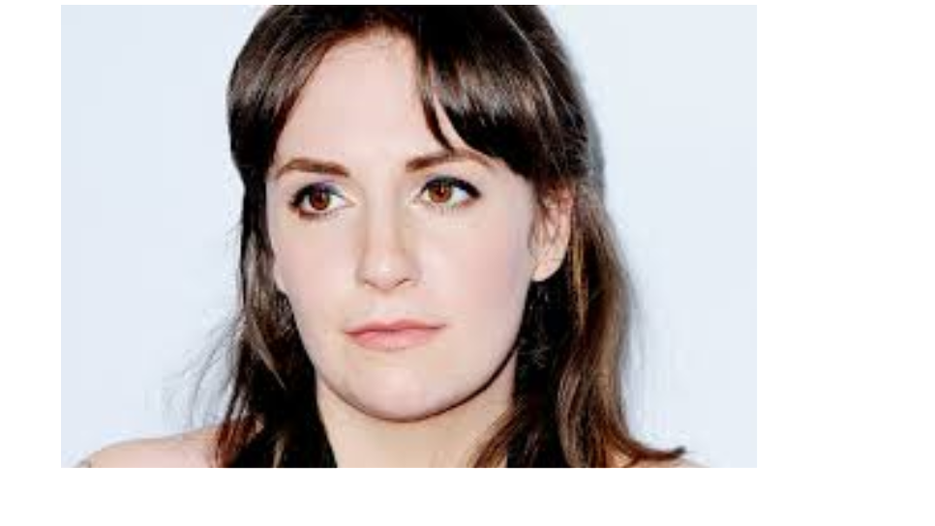
IMAGE 186*271

Slide 4
PD 90 PROTOCOL
STARTING WITH 1200 HZ.
STARTING OF LINE WITH 1500HZ.
PRINTING Y VALUES OF ODD LINE (LUMA/BRIGHTNESS).
PRINTING AVERAGE R-Y VALUE OF 2 LINES (RED – LUMINOUS SIGNAL).
PRINTING AVERAGE B-Y VALUE OF 2 LINES (BLUE-LUMINOUS SIGNAL).
PRINTING Y VALUES OF EVEN LINE (LUMA/BRIGHTNESS).

Slide 5
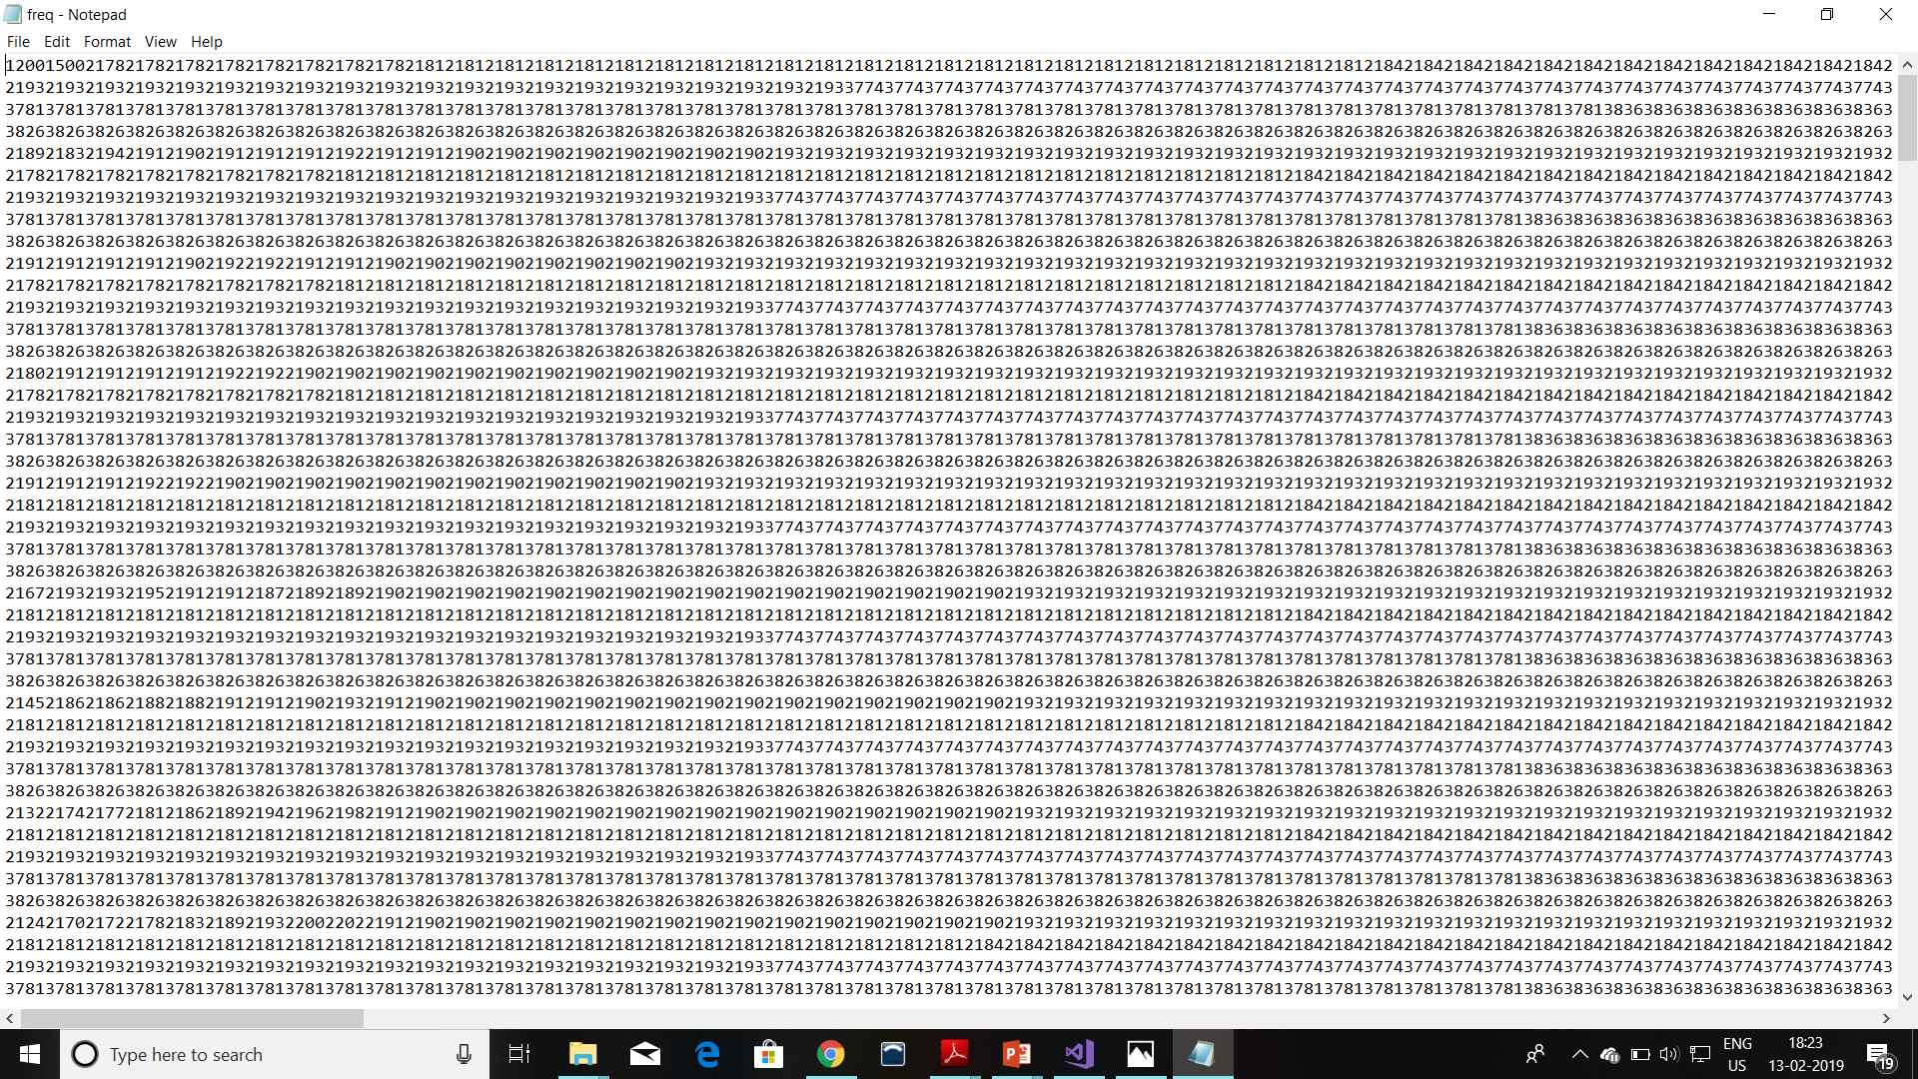
GENERATION OF TEXT FILE.

Slide 6

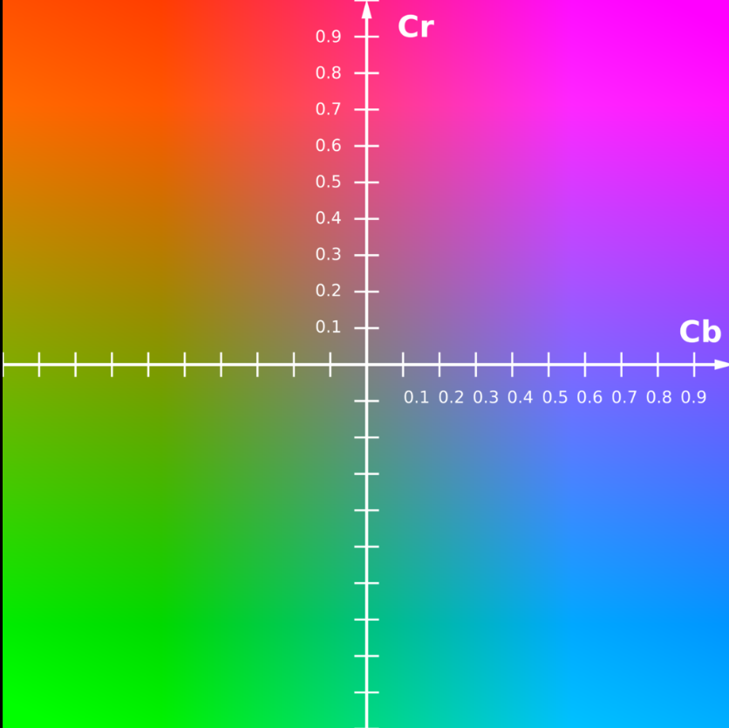

Slide 7
THE FIRST IMAGE SHOWS CHROMA (PURITY OR INTENSITY) Cr and CB.
THE SECOND IMAGE SHOWS Y COMPONENT , Cb COMPONENT , Cr COMPONENT
OF AN IMAGE.
CLEARLY IT CAN BE SEEN THAT CB AND CR COMPONENTS ARE FADED.

Slide 8
THAUGHT ABOUT DECREASING FILE SIZE.
REPRESENTATION OF FREQUENCY | HOW TO REPRESENT | FILE SIZE
4 digit | Using extracted frequency as it is. | 656 KB
3 digit | Converting it in window of 100-900 | 492 KB
2 digit | Using combination of ASCII characters | 328KB

Slide 9
THOUGHT ABOUT DECREASING FILE SIZE.
Actual size : - 256*320*4 + 128*320*4 + 128*320*4 + 256*4 = 656 KB.
Decreasing the size by decreasing number of digits.
The window of 1500 – 2300 can be shifted to 100 – 900.
So decreasing the size to (656)*3/4 = 492 KB

Slide 10
THOUGHT ABOUT DECREASING FILE SIZE.
Further we can decrease it to 2 characters combination.
By using appropriate and distinct ASCII combinations of 2 characters we can generate more than 8000 combinations .
So decreasing the file size to (656)*1/2 = 328 KB
But it will need a appropriate code to decode the values , if we wish to decrease the file size.

Slide 11
ATMEGA 128A USART CONCEPTS
CLASSIFICATION | DIFFERENT TYPES | USE | HIGH OR LOW
START BIT | Only 1 | To initialize sending data. | Always low.
DATA BITs | Any value between 5-9 | Carries number in Binary form. | According to representation.
STOP BITs | Can be 1 1.5 2 | To end the sending of data. | Always high.

Slide 12
ATMEGA 128A USART CONCEPTS
But what is 1.5 stop bit ?
It is a one stop bit transferred for 150% of time used to transmit one stop bit.
For ASCII 7 data bits are essential.
BAUD rate :- No. of bits that can be transformed per second

Slide 13
ATMEGA 128A USART CONCEPTS
Parity bit :- Use to detect corrupt data.
10010110 – generated data.
10010110 1 – data attached with parity bit.
10011110 1 -- SENT DATA (RED BIT IS CORRUPTED).

Slide 14
USE OF PYSERIAL
Why to use pyserial ?
Terminal is limited
Pyserial is vast and input can be given in many ways.
The output can also be processed , which can’t be done in terminal.

Slide 15
STEPS TO USE PYSERIAL
Initialize the communication with parameters used in USART communication.
Open the respective port .
Using appropriate syntax you can write and read from the port.

Slide 16
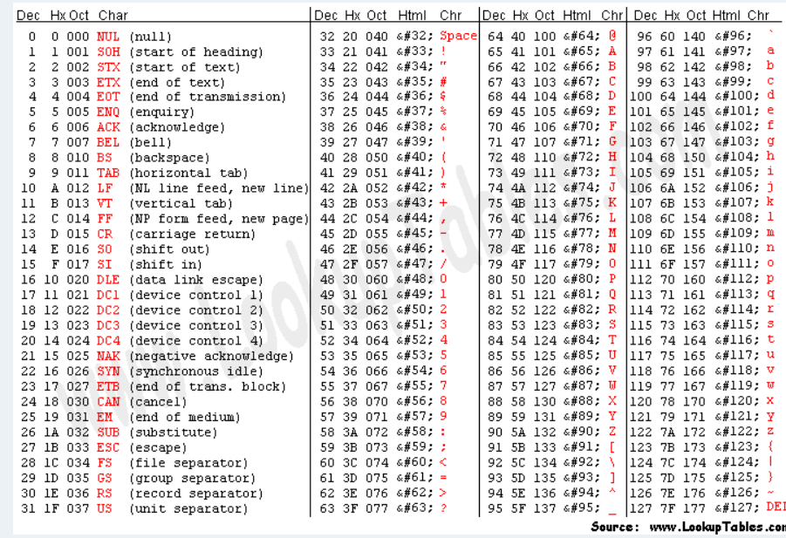
REFERENCE

Slide 17
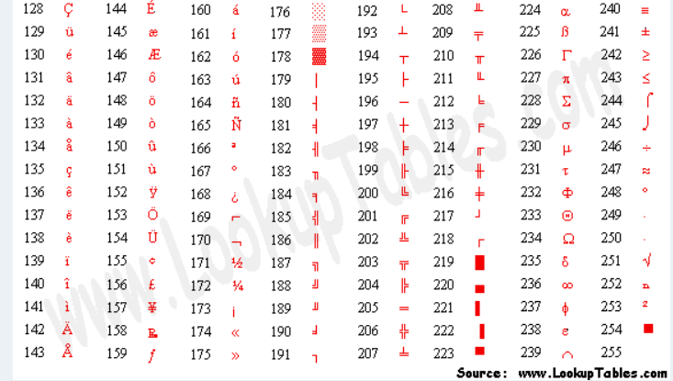
REFERENCE

